Slide 1
Fuzzing and Patch Analysis: SAGEly Advice

Slide 2
Introduction

Slide 3
Automated Test Generation
Goal: Exercise target program to achieve full coverage of all possible states influenced by external input
Code graph reachability exercise
Input interaction with conditional logic in program code determines what states you can reach

Slide 4
Automated Testing Approaches
Modern approaches fall into two buckets:
Random Testing (Fuzzing)
Zero-knowledge mutation
Syntax model based grammar
Direct API interrogation
Concolic Testing
Instrumented target program
Tracking of dataflow throughout execution
Observation of program branch logic & constraints
Symbolic reasoning about relationship between input and code logic
Notes:
AKA Concolic Testing

Slide 5
Advanced Fuzzing
Advanced Fuzzers derive grammars from well formed data samples or are given a manually constructed syntax & interaction model that is expressed in a higher level grammar
For automation, syntax is inferred using string grouping algorithms such as n-gram
A good modern example is Radamsa
Supply a corpus of well formed inputs
Multiple grammar inference strategies
Detection of repeated structures or identification of basic types is automatic

Slide 6
Limits to Fuzzing
Unfortunately even the most advanced fuzzers cannot cover all possible states because they are unaware of data constraints.
The below example would require an upper bound of 2^32 or 4 billion attempts to meet the condition required to trigger the crash
void test(char *buf)
{
int n=0;
if(buf[0] == 'b') n++;
if(buf[1] == 'a') n++;
if(buf[2] == 'd') n++;
if(buf[3] == '!') n++;
if(n==4) {
crash();
}
}

Slide 7
Concolic Testing
For anything beyond string grouping algorithms, direct instrumentation of the code and observation of interaction between data and conditional logic is required
Early academic work in this area:
DART: Directed Automated Random Testing
2005 - Patrice Godefroid, et al
CUTE: a concolic unit testing engine for C
2005 - Sen, Koushik
EXE: Automatically Generating Inputs of Death
2006 -Dawson Engler

Slide 8
Concolic Test Generation: Core Concepts

Slide 9
Code Coverage & Taint Analysis
Code Coverage
Analysis of program runtime to determine execution flow
Collect the sequence of execution of basic blocks and branch edges
Several approaches
Native debugger API
CPU Branch Interrupts
Static binary rewriting
Dynamic binary instrumentation

Slide 10
Code Coverage & Taint Analysis
Taint Analysis
Analysis of program runtime to determine data flow from external input throughout memory
Monitor each instruction for propagation of user controlled input from source operands to destination operands
Dependency tree is generated according to tainted data flows in memory or CPU registers
Taint analysis is imperfect – propagation rules must dictate the level of inferred dataflow that is propagated

Slide 11
Dynamic Binary Instrumentation
JIT modification of binary code
As new code blocks are visited or modules are loaded, an analysis phase disassembles the binary to identify code structure
Instructions may be inserted at arbitrary locations around or within the disassembled target binary
Modified code is cached and referenced instead of original binary
Skips some problems with static binary rewriting and maintains runtime state for conditional instrumentation

Slide 12
Symbolic Execution
Symbolic execution involves computation of a mathematical expression that represents the logic within a program.
It can be thought of as an algebra designed to express computation.
void test(char *buf)
{
int n = 0;
if(buf[0] == 'b') n++;
if(buf[1] == 'a') n++;
if(buf[2] == 'd') n++;
if(buf[3] == '!') n++;
if(n==4) {
crash();
}
}
(declare-const buf (Array Int Int))
(declare-fun test () Int)
(declare-const n Int)
(assert (= n 0))
(ite (= (select buf 0) 98) (+ n 1) 0)
(ite (= (select buf 1) 97) (+ n 1) 0)
(ite (= (select buf 2) 100) (+ n 1) 0)
(ite (= (select buf 3) 92) (+ n 1) 0)
(assert (= n 4))
(check-sat)
(get-model)

Slide 13
Symbolic Execution
Symbolic execution involves computation of a mathematical expression that represents the logic within a program.
It can be thought of as an algebra designed to express computation.
(declare-fun condition () Int)
(declare-const ret Int)
(declare-const x Int)
(assert (=> (>= x 50) (= ret 1)))
(assert (=> (< x 50) (= ret 2)))
(assert (= ret 1))
(check-sat)
(get-model)
---
sat
(model
(define-fun x () Int 50)
(define-fun ret () Int 1)
)
void condition(int x)
{
int ret = 0;
if (x > 50)
ret = 1;
else
ret = 2;
return ret
}

Slide 14
Symbolic Execution
Last year we used Symbolic Execution to emulate forward from a crash to determine exploitability
void test_motriage(unsigned int *buf)
{
unsigned int b,x,y;
b = buf[0];
x = buf[b+0x11223344];
y = buf[x];
exploit_me(1, x, y);
}

Slide 15
Symbolic Execution
Last year we used Symbolic Execution to emulate forward from a crash to determine exploitability
void exploit_me
(int depth,
unsigned int x,
unsigned int y)
{
int stack[1];
int b, i;
b = x & 0xff;
switch(depth) {
...
}
exploit_me(++depth, x>>8, y);
}
case 4:
if(b == 0x44)
stack[y] = 1;
return;
case 3:
if(b != 0x33) y = 0;
break;
case 2:
if(b != 0x22) y = 0;
break;
case 1:
if(b != 0x11) y = 0;
break;
default:
assert(0);

Slide 16
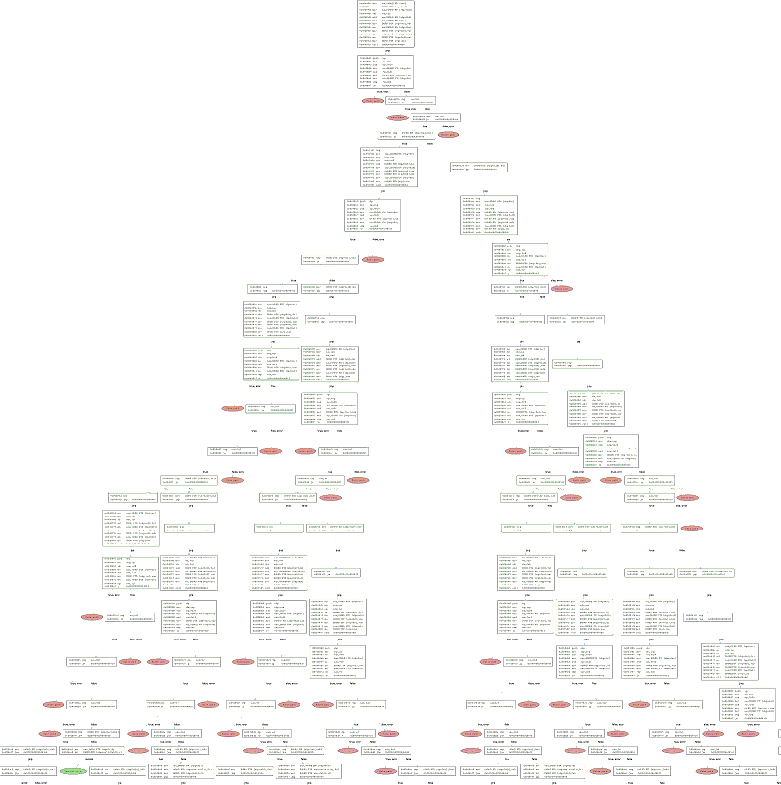
Symbolic Execution
Last year we used Symbolic Execution to emulate forward from a crash to determine exploitability
[insert screenshot of crashflow here]

Slide 17
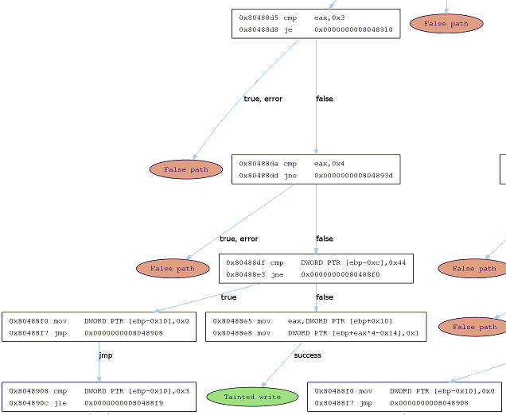

Slide 18
Constraint Generation
Comparisons are done on values to determine which branch of code to take:
We observe these constraints to determine what data value ranges allow execution in different paths
A code path is determined by collecting a series of these constraints which determines the execution flow of the program
if (a > b):
block1
else:
block2

Slide 19
Constraint Generation
Against binary targets we need to track flags and evaluate the dependent comparison before a jump
This may be done manually or through the use of an IR
0x080483d4 <+0>: push %ebp
0x080483d5 <+1>: mov %esp,%ebp
0x080483d7 <+3>: and $0xfffffff0,%esp
0x080483da <+6>: sub $0x10,%esp
0x080483dd <+9>: cmpl $0x1,0x8(%ebp)
0x080483e1 <+13>: jle 0x80483f1 <main+29>
0x080483e3 <+15>: movl $0x80484d0,(%esp)
0x080483ea <+22>: call 0x80482f0 <puts@plt>
0x080483ef <+27>: jmp 0x80483f2 <main+30>
0x080483f1 <+29>: nop
0x080483f2 <+30>: leave
0x080483f3 <+31>: ret
Notes:
Show a more realistic assembly dump showing flags and comparisons can occur higher up

Slide 20
Constraint Solving
A formula representing the code path logic is generated in a format acceptable to a symbolic execution engine
To explore alternate paths, we invert the conditional logic of the last branch and allow the solver to generate an example that would match the inverted conditional logic
Iterative use of this algorithm allows us to explore a complete program graph

Slide 21
Test Generation
Input: ‘bad?’
Formula generated by symbolic execution:
Φ:= (i₀=‘b’) && (i₁=‘a’) && (i₂=‘d’) && (i₃<>‘!’)
New formulas:
Φ₀:= (i₀=‘b’) && (i₁=‘a’) && (i₂=‘d’) && (i₃=‘!’)
Φ₁:= (i₀=‘b’) && (i₁=‘a’) && (i₂<>‘d’) && (i₃<>‘!’)
Φ₂:= (i₀=‘b’) && (i₁<>‘a’) && (i₂=‘d’) && (i₃<>‘!’)
Φ₃:= (i₀<>‘b’) && (i₁=‘a’) && (i₂=‘d’) && (i₃<>‘!’)

Slide 22
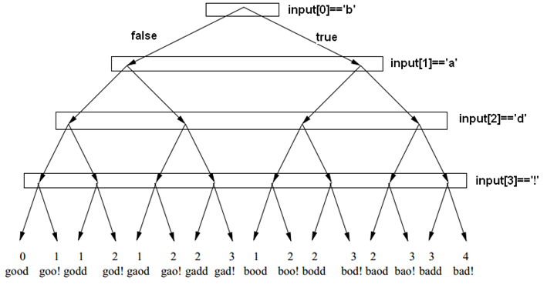
Test Generation

Slide 23
Microsoft SAGE

Slide 24
Implementation
Tester
AppVerifier crash harness
Tracer
iDNA DBI Framework
CoverageCollector
Coverage analysis of iDNA trace using Nirvana
SymbolicExecutor
X86->SMT translator and constraint collector over iDNA trace using TruScan
Disolver
Z3 constraint solver
Notes:
TruScan requires symbols, acts like virtual debugger. Includes disassembler, syscall i/o, stack/heap emulator, taint propagation

Slide 25
Optimizations
Generational Search vs DFS
DFS or BFS would negate only one of the branches
Generational search negates each condition and solves for each, generating many new inputs per symbolic execution phase instead of just one
Constraint Optimization
Constraint Elimination - reduces the size of constraint solver queries by removing the constraints which do not share symbolic variables with the negated constraint
Local constraint Caching - skips a constraint if it has already been added to the path constraint
Flip count limit - establishes the maximum number of times a constraint generated from a particular program instruction can be ﬂipped
Constraint Subsumption - tracks constraints dominated by a specific branch, skips identical constraints generated from the same instruction location

Slide 26
Results
Thousands of crashes found in the Windows 7 and Office products – 1/3 of all file fuzzing bugs since 2007
Lessons Learned
Vulnerabilities discovered are usually at shallow code depths
Symbolic Execution state is limited so wrappers need to be developed for library code
A small number of generations typically find the majority of vulnerabilities

Slide 27
Moflow::FuzzFlow

Slide 28
Implementation
Tracer
Modified BAP pintool to collect memory dumps, coverage information, input stream names. Detects exceptions as well
Symbolic Executor
Modification to BAP that supports converting BAP IL to SMTLIB formulas
SMT Solver
We use z3 or STP to solve generated formulas
FuzzFlow Logic
Custom tool built on top of BAP that glues all components together and implements the exploration algorithm

Slide 29
Limitations
Tracer
Taint tracer from BAP is not optimized
For this application, inputs over a few kB are problematic
PIN is unable to flush single basic block hooks from code cache for code coverage hit trace
Symbolic Execution
Slow conversion from BIL to SMTLIB on big traces
FuzzFlow
Libraries need to be wrapped directly
We lack most of the optimizations in SAGE such as constraint subsumption

Slide 30
Does It Blend?
int main(int argc, char *argv[]) { char buf[500]; size_t count; fd = open(argv[1], O_RDONLY); if(fd == -1) { perror("open"); exit(-1); } count = read(fd, buf, 500); if(count == -1) { perror("read"); exit(-1); } close(fd); test(buf); return 0;
}
void crash(){ int i; // Add some basic blocks for(i=0;i<10;i++){ i += 1; } *(int*)NULL = 0; }
void test(char * buf) { int n=0; if(buf[0] == 'b') n++; if(buf[1] == 'a') n++; if(buf[2] == 'd') n++; if(buf[3] == '!') n++; if(n==4){ crash(); } }

Slide 31
Does It Blend?
moflow@ubuntu:~/moflow-bap-0.7/custom_utils/egas$ ./egas -app test/bof1 -seed test/input.txt
Starting program
Thread 0 starting
Opening tainted file: samples/13.sol
Tainting 5 bytes from read at bffafe30
buffer_size: 5, requested length: 5
Taint introduction #0. @bffafe30/5 bytes: file samples/13.sol
adding new mapping from file samples/13.sol to 0 on taint num 1
adding new mapping from file samples/13.sol to 1 on taint num 2
adding new mapping from file samples/13.sol to 2 on taint num 3
adding new mapping from file samples/13.sol to 3 on taint num 4
adding new mapping from file samples/13.sol to 4 on taint num 5
Activating taint analysis
CRASH! Sample: samples/13.sol saved as crashes/2014-06-20_22:40:10_13.crash
----------STATS----------
% total count desc
68% 13s 9 taint tracing the target (produces .bpt)
16% 3s 14 gathering coverage info
5% 1s 9 symbolic execution
0% 0s 0 .bpt concretization
0% 0s 13 solver interaction
11% 2s 1 unaccounted
-------------------------
elapsed: 19.000000

Slide 32
Real World Vulnerability Discovery
moflow@ubuntu:~/moflow-bap-0.7/custom_utils/egas$ ./egas -app /home/moflow/graphite2-1.2.3/tests/comparerenderer/comparerenderer -seed /home/moflow/graphite2-1.2.3/tests/fonts/tiny.ttf -fmt "-t /home/moflow/graphite2-1.2.3/tests/texts/udhr_nep.txt -s 12 -f %s -n“
Breakpoint 1, _IO_fread (buf=0x0, size=1, count=3758096384, fp=0x8053230) at iofread.c:37
37 in iofread.c
(gdb) bt
#0 _IO_fread (buf=0x0, size=1, count=3758096384, fp=0x8053230) at iofread.c:37
#1 0x4003a8ca in graphite2::FileFace::get_table_fn(void const*, unsigned int, unsigned int*) ()
from /home/moflow/graphite2-1.2.3/src/libgraphite2.so.3
#2 0x4002e8e5 in graphite2::Face::Table::Table(graphite2::Face const&, graphite2::TtfUtil::Tag) ()
from /home/moflow/graphite2-1.2.3/src/libgraphite2.so.3
#3 0x4002858a in (anonymous namespace)::load_face(graphite2::Face&, unsigned int) ()
from /home/moflow/graphite2-1.2.3/src/libgraphite2.so.3
#4 0x40028695 in gr_make_face_with_ops () from /home/moflow/graphite2-1.2.3/src/libgraphite2.so.3
#5 0x40028aac in gr_make_file_face () from /home/moflow/graphite2-1.2.3/src/libgraphite2.so.3
#6 0x0804d56d in Gr2Face::Gr2Face(char const*, int, std::string const&, bool) ()
#7 0x0804b664 in main ()

Slide 33
Real World Vulnerability Discovery
const void *FileFace::get_table_fn(const void* appFaceHandle, unsigned int name, size_t *len)
{
if (appFaceHandle == 0) return 0;
const FileFace & file_face = *static_cast<const FileFace *>(appFaceHandle);
void *tbl;
size_t tbl_offset, tbl_len;
if (!TtfUtil::GetTableInfo(name, file_face._header_tbl,
file_face._table_dir, tbl_offset, tbl_len))
return 0;
if (tbl_offset + tbl_len > file_face._file_len
|| fseek(file_face._file, tbl_offset, SEEK_SET) != 0)
return 0;
tbl = malloc(tbl_len);
if (fread(tbl, 1, tbl_len, file_face._file) != tbl_len)
{
free(tbl);
return 0;
}
if (len) *len = tbl_len;
return tbl;
}
Notes:
malloc fails, cannot read into null buffer

Slide 34
Binary Differencing

Slide 35
The Good Old Days
In 2004, Halvar was the first to apply isomorphic graph comparison to the problem of binary program differencing
The primary class of vulnerabilities at the time were Integer Overflows
“Integer overflows are heavily represented in OS vendor advisories, rising to number 2 in 2006” http://cwe.mitre.org/documents/vuln-trends/index.html
Integer Overflows are localized vulnerabilities that result in array indexing or heap allocation size miscalculations
Many vulnerabilities were targeting file formats such a Microsoft Office

Slide 36
BinDiff in 2014
Last update for the only commercialized BinDiff tool (Zynamics BinDiff) was in 2011
The majority of vulnerabilities being patched by Microsoft are use-after-free bugs in Internet Explorer which has a high degree of separation between the root cause that gets patched and the actual code path that can trigger the bug leading to an exploitable condition
First added to CWE in 2008, now dominates as a vulnerability class in web-browsers and document parsers

Slide 37
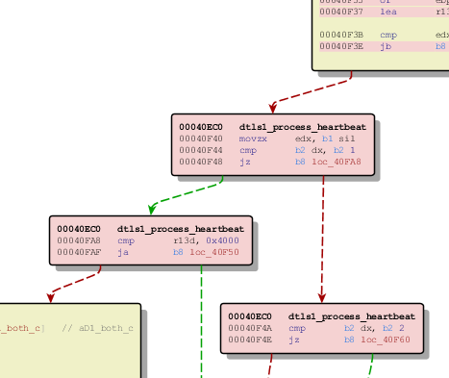
Inline Bounds Checking

Slide 38
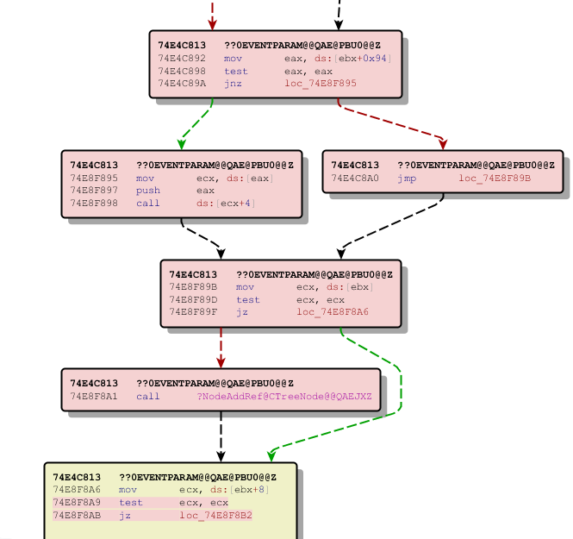
Use-After-Free

Slide 39
Function Matching
Hash Matching (bytes/names)
MD index matching (flowgraph/callgraph, up/down)
Instruction count
Address sequence
String references
Loop count
Call sequence

Slide 40
Basic Block Matching
Edges Prime Product
Hash/Prime
MD index (flowgraph/callgraph, up/down)
Loop entry
Entry/Exit point
Jump sequence

Slide 41
Practical Problems
Mismatched functions
Some functions are identical in both binaries, but mismatched by the differ
Assembly refactoring
Some functions are semantically identical in both binaries, but some assembly instructions have changed/moved
Little to no context
Functions are given a similarity rating, but no potential indicators of security-related additions

Slide 42
Practical Problems
Compiler optimizations are not handled
Chunked functions are not handled
BinDiff heuristics are not tunable / configurable
IDA misidentifies data as code
UAF vulnerabilities are hard to reverse engineer
The DOM is massive and interactions between objects are not defined
The patches are typically simple reference counting patches (add missing calls to AddRef)

Slide 43
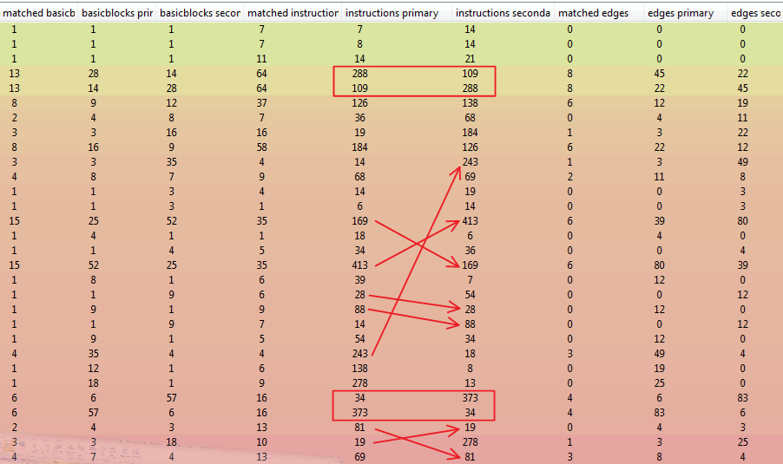
Mismatched Functions

Slide 44
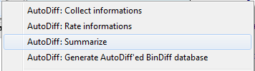
AutoDiff
Our solution is to post-process the database generated from BinDiff
We augment the existing database by performing further analysis with IDApython scripts
New tables are added to supplement the existing information

Slide 45
AutoDiff
Features
Instruction counting (including chunked function)
Instructions added/removed from each function
IntSafe library awareness
Filtering of innocuous / superfluous changes
Filtering of changes without a security impact
Example: new ‘ret’ instructions generated by compiler
Mnemonic list comparison
To determine when register substitution is the only change

Slide 46
Results
MS13-097 – ieinstal.dll: 19% reduction
=======================================================
= AutoDiff / Statistics =
=======================================================
Number of changed functions declared by BinDiff : 179
Number of functions filtered out by Sanitizer : 26
Number of functions contain "IntSafe patch" : 1
Number of functions ReMatched : 7
Number of functions still left to analysis : 145

Slide 47
Results
MS14-017 – wordcnv.dll: 76% reduction
=======================================================
= AutoDiff / Statistics =
=======================================================
Number of changed functions declared by BinDiff : 55
Number of functions filtered out by Sanitizer : 0
Number of functions contain "IntSafe patch" : 0
Number of functions ReMatched : 42
Number of functions still left to analysis : 13

Slide 48
Results
MS14-035 – urlmon.dll: 29% reduction
=======================================================
= AutoDiff / Statistics =
=======================================================
Number of changed functions declared by BinDiff : 31
Number of functions filtered out by Sanitizer : 9
Number of functions contain "IntSafe patch" : 0
Number of functions ReMatched : 0
Number of functions still left to analysis : 22

Slide 49
Results
MS14-035 – mshtml.dll: 21% reduction
=======================================================
= AutoDiff / Statistics =
=======================================================
Number of changed functions declared by BinDiff : 543
Number of functions filtered out by Sanitizer : 56
Number of functions contain "IntSafe patch" : 0
Number of functions ReMatched : 61
Number of functions still left to analysis : 426

Slide 50
Results
Adobe CVE-2014-0497: 87% reduction
=======================================================
= AutoDiff / Statistics =
=======================================================
Number of changed functions declared by BinDiff : 1118
Number of functions filtered out by Sanitizer : 975
Number of functions contain "IntSafe patch" : 0
Number of functions ReMatched : 0
Number of functions still left to analysis : 143

Slide 51
Semantic Difference Engine

Slide 52
BinDiff Problem Areas
Reassignment of registers while maintaining the same semantics
Inversion of branch logic
such as jge -> jl
Using more optimized assembler instructions that are semantically equivalent

Slide 53
The Idea
We've shown success using symbolic execution to analyze code paths to generate inputs
We should be able to ask a solver to tell us if two sets of code are equivalent
In last year's presentation we showed an example of exactly this
Is “add eax, ebx” equivalent to this code:
add eax, ebx
xor ebx, ebx
sub ecx, 0x123
setz bl
add eax, ebx

Slide 54
The Idea
add eax, ebx
xor ebx, ebx
sub ecx, 0x123
setz bl
add eax, ebx
ASSERT( 0bin1 = (LET initial_EBX_77_0 = R_EBX_6 IN (LET initial_EAX_78_1 = R_EAX_5 IN (LET R_EAX_80_2 = BVPLUS(32, R_EAX_5,R_EBX_6) IN (LET R_ECX_117_3 = BVSUB(32, R_ECX_7,0hex00000123) IN (LET R_ZF_144_4 = IF (0hex00000000=R_ECX_117_3) THEN 0bin1 ELSE 0bin0 ENDIF IN (LET R_EAX_149_5 = BVPLUS(32, R_EAX_80_2, (0bin0000000000000000000000000000000 @ R_ZF_144_4)) IN (LET final_EAX_180_6 = R_EAX_149_5 IN IF (NOT(final_EAX_180_6=BVPLUS(32, initial_EAX_78_1,initial_EBX_77_0))) THEN ); QUERY(FALSE); COUNTEREXAMPLE;
Model:
R_ECX_7 -> 0x123
Solve result: Invalid

Slide 55
The Idea
Strategy would be to mark function parameters as symbolic and discover each path constraint to solve for inputs that would reach all paths
At termination of each path the resulting CPU state and variable values should be identical
Unfortunately this led to a false impression of the feasibility of this approach

Slide 56
The Reality
Low level IR is tied to a memory and register model
This level of abstraction does not sufficiently alias references to the same memory
At minimum private symbol information would be needed to abstract beyond the memory addresses so we could manually match the values
Decompilation would be a better first step towards this strategy, but symbol names are not guaranteed to match

Slide 57
A Practical Approach
David Ramos and Dawson Engler published "Practical, low-effort equivalence veriﬁcation of real code" which shows a technique for performing a semantic equivalence test against source code using a modified version of KLEE
Original application was for program verification of new implementations vs reference implementations, our problem is a subset of this
Turns out the approach is nearly identical but works on a higher level of abstraction

Slide 58
A Practical Approach
Code is compiled with symbol information using KLEE/LLVM
A test harness is linked against each of the two functions to be compared
The harness marks each parameter of the two functions as symbolic
If input parameters are dereferenced as pointers, memory is lazily allocated as symbolic values
Symbolically executes each function for each discovered constraint
At the end of execution, KLEE traverses each memory location and solves for equivalent values at each location
On failure of this check, a concrete input is generated that can prove the functions are different, else they've been proven equal

Slide 59
Where to Next
The ability to alias memory references through the use of symbol information is the crucial missing piece of the puzzle for our approach
There are additional difficulties with reference tracking, object comparison for passed parameters or return values, as well as overlapping memory references
They explicitly specify that inline assembler is not handled due to their reliance on symbol information

Slide 60
Conclusions

Slide 61
Thank You!
Sourcefire VulnDev Team
Richard Johnson
rjohnson@sourcefire.com
@richinseattle
Ryan Pentney
Marcin Noga
Yves Younan
Pawel Janic (emeritus)
Code release will be announced on
http://vrt-blog.snort.org/

